Slide 1

Community Action Fund Funding Reporting Tool (CRT) Recipient User Guide
To hear the
Webinar you must
join the teleconference
1-877-413-4790
Participant pass code: 210 409 8#
Your teleconference line will be muted.
The webinar will begin at 1pm EST

Slide 2
Community Action Fund Funding Reporting Tool (CRT) Recipient User Guide
March - April 2018
Notes:
Okay let’s begin. Welcome to the Community Action Fund Reporting Tool User Guide webinar.
We are very pleased to have you all join in to today’s presentation.
You may have noticed that the teleconference line has been muted - this is to reduce background noise. If you are having technical issues and need help, or if you have questions during today’s presentation, you can reach us by typing into the chat box found on the right hand side of your screen. First click on the “chat” icon found on the top right side of the screen. Once the chat function opens, you can type your question or request into the rectangle that will appear, and please make sure “Host” appears in the “Send to” box or use the drop down menu on the right to select Host, and then press send. Your note will appear above, which means it has been sent.
Our goal today is to help you get comfortable with the CRT, help you understand our expectations regarding the data the CRT collects, and to address any questions or concerns you may have.
We encourage you to ask questions that are related to the content of this webinar and that apply to projects in general. If you have any project-specific questions, please contact your Program Consultant and they will be happy to help. Please note that we will answer questions at the end of the webinar. We will also distribute the power point presentation and notes to all participants.
Finally we want to start by thanking you all for your hard work and efforts over the past year. We know that developing SMART Objectives, outputs, a work plan and an evaluation plan for your project can be a challenging task and we appreciate your efforts.

Slide 3
You will have received a personalized copy of the CRT in excel
You should have received a copy of the CRT in excel by now – if not please contact your program consultant
Each CRT has been set up with information specific to each project
Items such as your SMART objectives and key year one outcomes have been imported to the tool
These items will populate dropdown menus throughout the survey
You should also have a copy of the CRT user guide
It would be helpful to open the CRT and follow along with todays’ presentation
Notes:
By now you should have received a personalized copy of the CAF reporting tool in excel.
Each CRT is unique and tailored to your specific project. Information that you have provided over the past few weeks and months, including your SMART objectives and outputs has been imported into the CRT. This information is used to populate dropdown menus throughout the tool in order to better enable you to directly link the CRT with your project plans.
You should have also received a copy of the CRT user guide. We strongly encourage you to review this document as it contains many definitions, examples, and tips on completing the CRT.
Before advancing I’d like to note that you may find it helpful to have a copy of the CRT open so you can follow along with todays’ presentation.
If you have not received the tool or the guide please contact your program consultant.

Slide 4
Overview
Context
Excel basics
Introduction to the CRT
CRT Section 1: General Information
CRT Section 2: The Progress Report
CRT Section 3: The Reporting Tool
Questions
Notes:
We’ll cover several different topics in todays presentation. First we’ll do a quick overview of the CAF reporting requirement and how the CRT fits in. Then we’ll do a quick guide to using and navigating Microsoft excel. Then we’ll look at some of the mechanics within the CRT. Next well look at the General Information section of the tool. After that we’ll look at the Progress Report Section. We’ll conclude the presentation by going through each question in the reporting tool section and then we’ll open up for questions.

Slide 5
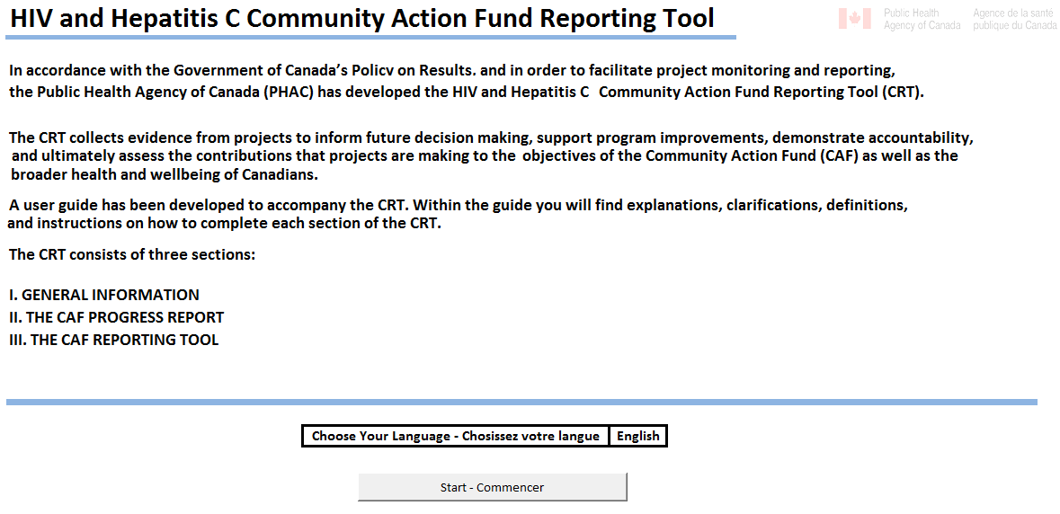
CONTEXT
CAF REPORTING REQUIREMENTS:
Annual Progress Report (annual or semi-annual)
Annual Performance Measurement & Evaluation Requirements Report (Contribution Agreement: Section 8.1; Québec: Section 16)
Both annual reports have been integrated into one Excel© document: the CRT
Notes:
Speaking points:
The Contribution Agreement identifies four types of reporting requirements
Annual Progress Report
Annual Performance Measurement Report, which includes the Performance Measurement & Evaluation Requirements Report (Section 8.1 , Québec: Section 16)
Preliminary Evaluation Report (Contribution Agreement Section 9.1, Québec: Section 16)
Final Evaluation Report (Contribution Agreement Section 9.1, Québec: Section 16)
This presentation is about the progress and the performance measurement annual reports
Both annual reports have been integrated into one Excel document: the CRT This means that there is a single data collection tool for reporting progress of project activities and performance measures.

Slide 6
Excel© Basics
Navigation
Arrow keys (↑, ↓, ←, →): move the cursor one cell in the direction of the arrow
Enter: Moves the cursor down one row
Shift+Enter: Moves the cell cursor up one row
Esc: Cancels any changes made to a cell
Selecting and Editing Cells
You can select a cell by clicking on it. The active cell will be highlighted by a thick black band
When a cell is selected anything you type will overwrite anything already in the cell. To edit data within a cell (without overwriting it) double click on the cell. This will bring up a cursor similar to what you would see in a word processing document
Notes:
At this point we will highlight a few key pointers regarding excel.
To navigate in excel
Arrow keys (↑, ↓, ←, →): move the cursor one cell in the direction of the arrow
Enter: Moves the cursor down one row
Shift+Enter: Moves the cell cursor up one row
Esc: Cancels any changes made to a cell
You can select a cell by clicking on it. The active cell will be highlighted by a thick black band
When a cell is selected anything you type will overwrite anything already in the cell. To edit data within a cell (without overwriting it) double click on the cell. This will bring up a cursor similar to what you would see in a word processing document

Slide 7
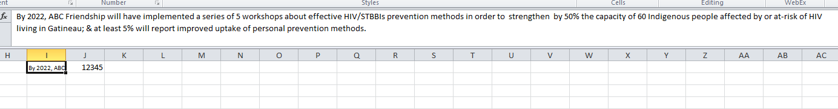
Excel Basics (Continued)
Sometimes a cell may contain data that is too long to be read in the cell itself.
The contents of whatever cell you have selected will appear in the formula bar at the top of the page.
Notes:
Read slide.

Slide 8
Introduction to the CRT
Notes:
Next we’ll cover a few housekeeping items regarding the tool

Slide 9
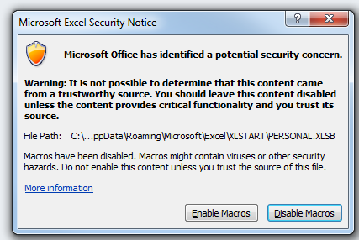
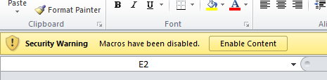
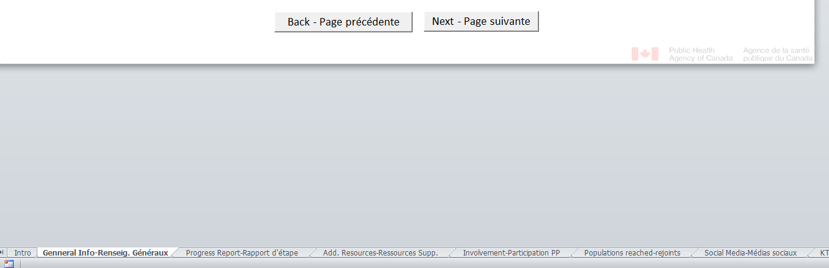
Intro
Enable Macros
Choose language
Forward and back buttons
Notes:
When you first open the tool you will be presented with a security warning asking you to enable or disable macros. Several parts of the tool run on macros, which are basically a way to automate certain functions within excel. We would ask that you click Enable macros. Depending on your security settings the file may also open in read only mode and you will need to enable editing by clicking the bar near the top of the page. You may then have to re-enable macros by clicking enable content on the same bar.
Once you get to the Intro page you will notice that you can select your language from the Choose your language bar.
To navigate throughout the tool you can use the Forward and Back buttons which can be found at the bottom of the page. Alternatively you can click on specific tabs at the bottom of the excel window.

Slide 10
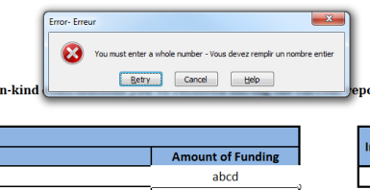
The CRT has been set up so those cells which do not require you to enter data are read only. Attempts to edit these cells will return an error message.
Additionally some cells force you to enter certain types of data such as whole numbers. Entering invalid data will return an error. If you see one of these errors simply click cancel and enter your data again.
Notes:
Read slide

Slide 11
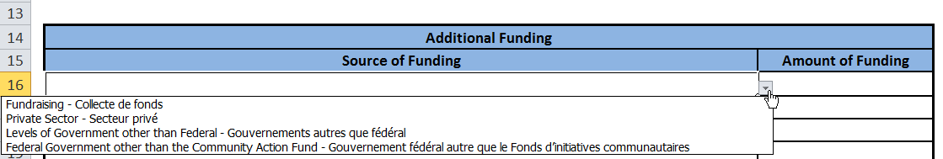
A number of cells are pre-populated with dropdown menus. When you select these cells you will see a small arrow. Clicking the arrow will open the dropdown menu.
Notes:
Read slide

Slide 12
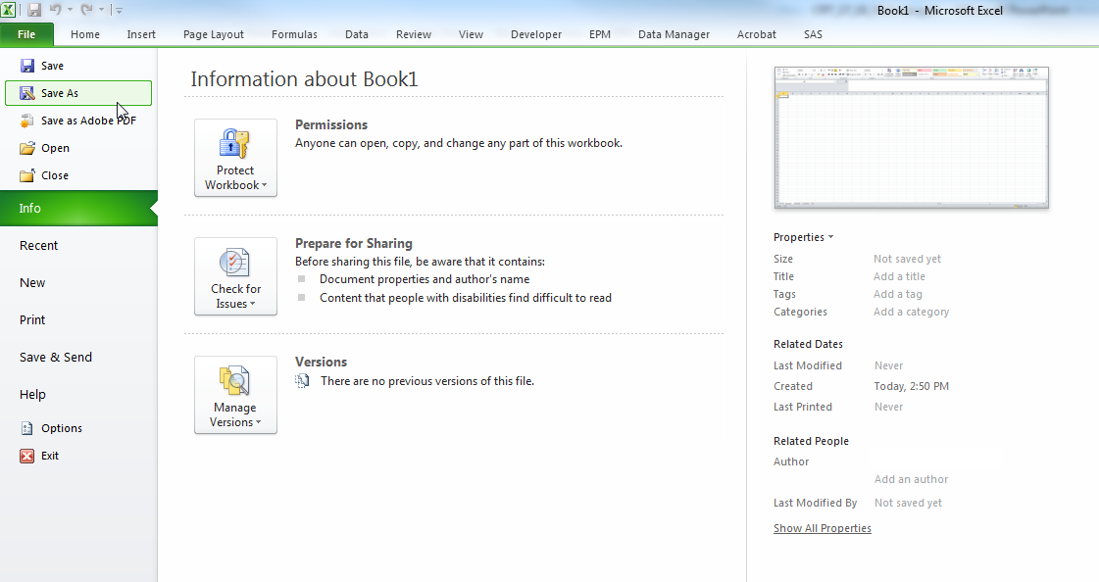
Before You Begin Completing your CRT
Save your work locally
Use “Save As” not “Save” the first time you save or you may loose your data
Save Early, Save Often
Notes:
Before you begin to fill out your CRT we strongly advise that you create a local save of the document. Please note that the first time you save, it is very important that you use the “save as” function and not the “save” function. Because the CRT is an email attachment the default save location will be a temporary file and saving here will result in the loss of your data. By using the save as function you will be able to specify a location to save your file in. Once you’ve identified a local file you can use the save function for subsequent saves.
We also suggest that you save often while you fill out the CRT just in case.

Slide 13
SECTION 1: General Information
Notes:
So lets get into the tool. We’ll start with section 1 which covers general information.

Slide 14
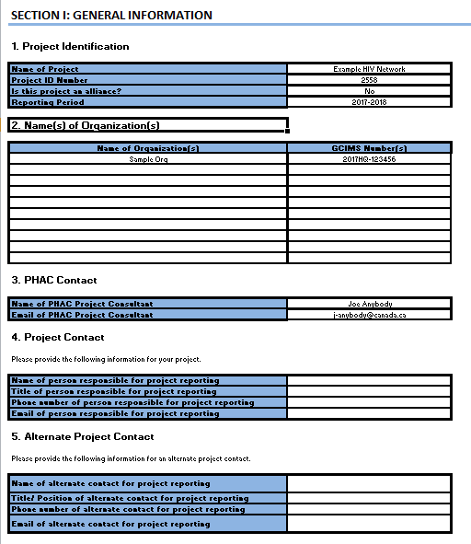
General Info
Most of this section will be pre imported from our records
Please provide Contact Information
One contact and one alternate contact even for alliances
Notes:
This Section contains general information on your project name, organization(s), reporting period and project contacts. In order to streamline the survey, the majority of this section has been imported from our records.
You are required to include the contact details for the person responsible for project reporting and an alternate contact. These people will be our point of contact should there be any questions or need for clarification.
For projects that are an alliance of organizations, how you choose to share responsibility for completing the CRT will need to be determined within the alliance. We only require one main contact and one alternate for the whole project. Each organization in an alliance should have received a copy of the CRT for informational purposes but you should only return one final copy for the alliance as a whole.

Slide 15
SECTION 2: Progress Report
Notes:
This takes us to Section 2 the progress report.

Slide 16
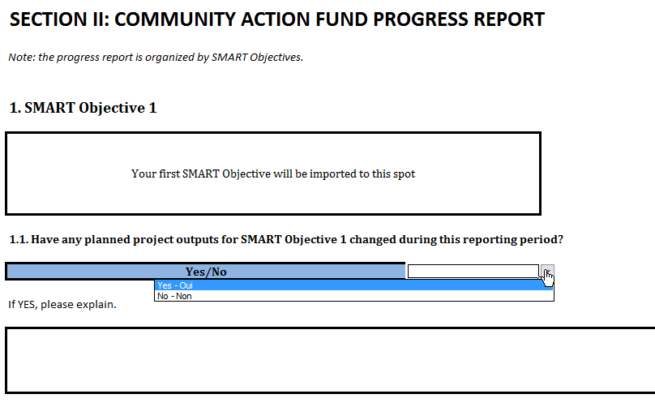
Progress Report
Tracks objectives and activities over the course of the reporting period
Organized by SMART Objective
Notes:
This Section gives you an opportunity to provide an update on your project activities and completed outputs as defined by the project work and evaluation plans. This section is organized by SMART objective. All questions are repeated and must be answered for each of your project SMART objectives. The example you see here is for our hypothetical project’s first SMART objective.
Question 1.1 asks about any changes made to your outputs. This is your opportunity to discuss any changes that you made to your plans such as adding/removing outputs and reasons for doing so. If you made changes select yes from the yes/no dropdown menu and then enter your explanations in the box provided. If you didn’t make any changes simply choose no and move on to the next question.

Slide 17
Progress Report (continued)
Output | Was the output completed within the specified timeline? | If you are not on track to meet this timeline, please explain why. | If you are not on track to meet this timeline, please indicate a revised timeline for completing this output | Did you conduct any evaluations for this output?
Notes:
Question 1.2 asks you to provide information on each of the outputs you listed in your work plan. We’ll go through the table one column at a time for a hypothetical project.

Slide 18
Progress Report (continued)
Output | Was the output completed within the specified timeline? | If you are not on track to meet this timeline, please explain why. | If you are not on track to meet this timeline, please indicate a revised timeline for completing this output | Did you conduct any evaluations for this output?
5 workshops
10 e-learning sessions
Notes:
First select an output from the dropdown menu. Outputs, like SMART objectives, will be imported to the question. In the example we have 2 outputs, 5 workshops and 10 e-learning sessions

Slide 19
Progress Report (continued)
Output | Was the output completed within the specified timeline? | If you are not on track to meet this timeline, please explain why. | If you are not on track to meet this timeline, please indicate a revised timeline for completing this output | Did you conduct any evaluations for this output?
5 workshops | Yes
10 e-learning sessions | No
Notes:
Next please indicate by a YES or a NO if your project has completed each identified output within the timeline listed in your work plan. If the output has been completed within this timeline, your answer should be YES. If the output has not been completed within this timeline, your answer should be NO. As we see in the table we completed our workshops but not our e-learning sessions.

Slide 20
Progress Report (continued)
Output | Was the output completed within the specified timeline? | If you are not on track to meet this timeline, please explain why. | If you are not on track to meet this timeline, please indicate a revised timeline for completing this output | Did you conduct any evaluations for this output?
5 workshops | Yes
10 e-learning sessions | No | Difficulty reaching audiences | Year 2
Notes:
If you will not meet the timeline specified in your workplan please give a short explanation why and indicate a revised timeline. Please note when revising your workplan you must consult with and get approval from your PC. Filling in this table, for each of your SMART objectives without prior approval from your Program Consultant does not imply approval.
If you are on track to meet your timelines then leave these two columns blank and proceed to the last column.

Slide 21
Progress Report (continued)
Output | Was the output completed within the specified timeline? | If you are not on track to meet this timeline, please explain why. | If you are not on track to meet this timeline, please indicate a revised timeline for completing this output | Did you conduct any evaluations for this output?
5 workshops | Yes |  |  | Yes
10 e-learning sessions | No | Difficulty reaching audiences | Year 2 | No
Notes:
In the last column, please indicate by a YES or a NO if this output has been evaluated? If YES, please report results in Question 6 (Section III). In our example we see that we did evaluations for our 5 workshops but not for our e-learning sessions.
You’ll repeat this process for each output you listed under SMART objective 1 and then repeat again for each of your other SMART objectives.

Slide 22
SECTION 3: CAF Reporting Tool
Notes:
This takes us to the Reporting Tool. This Section collects a range of information on your project and project activities.

Slide 23
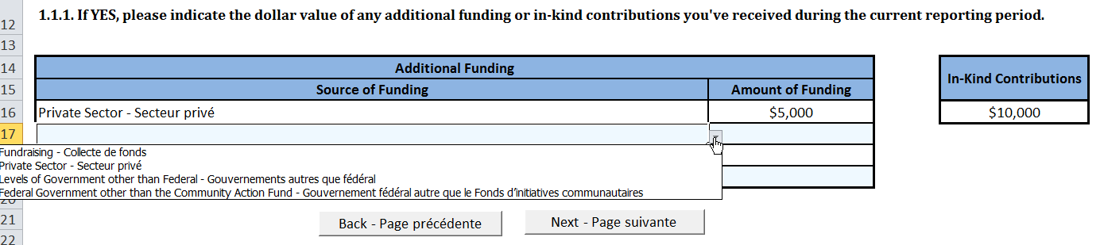
1. Additional Resources
Additional Funding
Select a source of the funding from the dropdown menu
Indicate the total amount of funding leveraged from that source.
In-Kind Contributions
Enter the total value of all in-kind contributions you received
Use whole numbers
Notes:
The following questions identify sources of funding (other than the Community Action Fund) that have been invested in you project. It includes any additional monetary contributions as well as in-kind contributions. Please note that this information is specific to the project funded under the CAF and not about your organization.
If you have received monetary contributions for your project other than CAF funding, please include the monetary amount ($) under the first table. To complete this table simply choose a source of funding from the dropdown menu and indicate the total amount of funds leveraged from that source.
In the example we see that $5000 were raised from private sector contributions.
You can add as many sources as you need but you should only list a source once. For example if you held 2 fundraisers that raised $200 and $300 dollars respectively you should only enter fundraisers once and provide the total amount raised, in this case $500.
If you have received in-kind contributions for your project, please include an estimated monetary value under the second table. You are only required to give the total value of all in-kind contributions. Please note there is no specific formula for this we ask that you consider how much these goods would have cost had you purchased them.

Slide 24
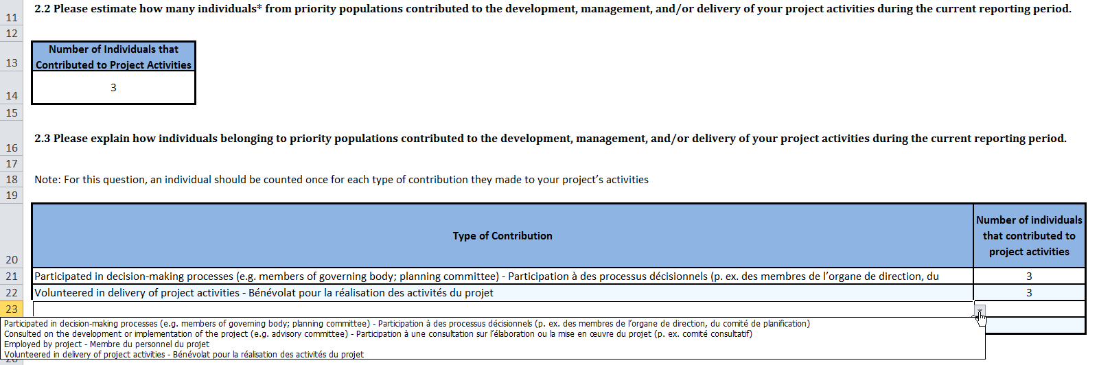
2. Priority Population Involvement
Question 2.1: Did individuals from priority populations contribute to your project?
Question 2.2: How many individuals contributed?
Count each individual once
Question 2.3: How did individuals contribute?
Each individual should be counted once per type of contribution but could contribute in multiple ways
Notes:
The next section assess the extent to which priority populations are involved in the implementation, decision-making, and governance of your project and project activities.
We’ will start with question 2.1. You are to respond YES to this question if one or more individuals from priority populations contributed to the development, management and/or delivery of project activities. Individuals who were reached through the project activities should not be reported in this question.
Question 2.2 asks you to indicate how many individuals contributed to your project. For this question you should count each individual only once regardless of how many times or ways they contributed.
For example if Mary, Bobby, and Joe each volunteered in the delivery of activities and they each also sat on the project’s board of directors they still only count as 3 individuals. In addition its important to highlight that you can estimate this total. We are not expecting you to track individuals in order to product an exact number.
In question 2.3 we’re looking for information on how individuals contributed. To complete this table simply select a type of contribution from the dropdown menu and indicate how many individuals contributed in that way. To continue our example of Mary, Bobby, and Joe we see that each was involved in volunteering and sitting on the board.
When completing question 2.3 one person could be listed as having contributed in more than one way but they should only be counted once per type of contribution. A person who volunteers 10 times should still only be counted once under the volunteered category.

Slide 25
3.Reach
Question 3.1.1 Total number of Unique Individuals reached
Direct Contact
Count each individual once
Estimates are okay – we do not expect you to keep records of individuals
 | Workshop 1 | Workshop 2
 | Bob | Bob
 | Pierre | Pierre
 | Jane | Stephen
 | Sophie | Therese
 | Bill | Joe
 | Jen | Michelle
Total | 6 | 6
Total Number of Unique Individuals Reached | 10
Notes:
The questions in the next section cover how your project reached its intended priority populations and/or target audiences.
Please note that reach refers only to direct contact by your project with members of priority populations and/or target audiences through specific activities such as workshops, webinars, or outreach activities. It does not include mass media campaigns such as social media use, poster campaigns, mail-outs, etc.
Question 3.1.1 asks you to indicate the total number of unique individuals who were reached through project activities. To answer this question, we are asking you to count each individual only once, regardless of how often they participated in different project activities.
For example in the table before you we have the attendance lists from two workshops. There are 12 names altogether but Robert and Pierre attended each workshop. So if we remove the duplicates then the total which would go into question 3.1.1 is 10.
We recognize that asking organizations to track participants of their project activities could be impractical and/or be challenging to individual privacy. We understand that not all organizations will be able to provide an exact figure in response to this question. Our expectation is that you include a reasonable estimate of the overall reach of your project.

Slide 26
3. Reach Continued
Question 3.1.2
National HIV Project
SMART Objective
By 2022, ABC Friendship will have implemented a series of 5 workshops about effective HIV/STBBIs prevention methods in order to strengthen by 50% the capacity of 60 Indigenous people affected by or at-risk of HIV living in Gatineau; & at least 5% will report improved uptake of personal prevention methods.
Outputs for Year 1
5 workshops in Ottawa
SMART Objective | Output | First Three Digits of Postal Code Where Activity Took Place | No. of Individuals Reached
Notes:
Table 3.1.2 connects the individuals you reached to your objectives and outputs.
We’ll go through a short example that will help illustrate how to complete this question
Our Project, we’ll call it the ABC Friendship Center, is holding workshops in order to increase capacity and ultimately change behavior.
Lets’ look at how you would report on the reach for these 5 workshops.

Slide 27
SMART Objective | Output | First Three Digits of Postal Code Where Activity Took Place | No. of Individuals Reached
By 2022, ABC Friendship will have implemented a series of 5 workshops about effective HIV/STBBIs prevention methods in order to strengthen by 50% the capacity of 60 Indigenous people affected by or at-risk of HIV living in Gatineau; & at least 5% will report improved uptake of personal prevention methods.
Notes:
So we start by identifying the SMART objective that this output supported. In the CRT you can select from the dropdown menu.

Slide 28
SMART Objective | Output | First Three Digits of Postal Code Where Activity Took Place | No. of Individuals Reached
By 2022, ABC Friendship will have implemented a series of 5 workshops about effective HIV/STBBIs prevention methods in order to strengthen by 50% the capacity of 60 Indigenous people affected by or at-risk of HIV living in Gatineau; & at least 5% will report improved uptake of personal prevention methods. | 5 workshops in Ottawa
Notes:
Then we’ll add the output itself, again in the CRT this will be in the dropdown menu. Note that all 5 workshops are together. We’re looking for reach per output not necessarily per specific activities. Because the 5 workshops were all part of the same output we treat them as one and report the total reach across the 5 workshops.

Slide 29
SMART Objective | Output | First Three Digits of Postal Code Where Activity Took Place | No. of Individuals Reached
By 2022, ABC Friendship will have implemented a series of 5 workshops about effective HIV/STBBIs prevention methods in order to strengthen by 50% the capacity of 60 Indigenous people affected by or at-risk of HIV living in Gatineau; & at least 5% will report improved uptake of personal prevention methods. | 5 workshops in Ottawa | K1A
Notes:
It took place in Ottawa so we’ll enter an Ottawa postal code.
Now, what if the workshops occurred in 2 locations say Ottawa and Toronto. In that case we would enter the output on two lines and report the reach for each location separately. You are able to repeat objectives and outputs as often as you need to.

Slide 30
SMART Objective | Output | First Three Digits of Postal Code Where Activity Took Place | No. of Individuals Reached
By 2022, ABC Friendship will have implemented a series of 5 workshops about effective HIV/STBBIs prevention methods in order to strengthen by 50% the capacity of 60 Indigenous people affected by or at-risk of HIV living in Gatineau; & at least 5% will report improved uptake of personal prevention methods. | 5 workshops in Ottawa | K1A | 20
Notes:
Finally we’ll enter the actual number of people we reached.

Slide 31
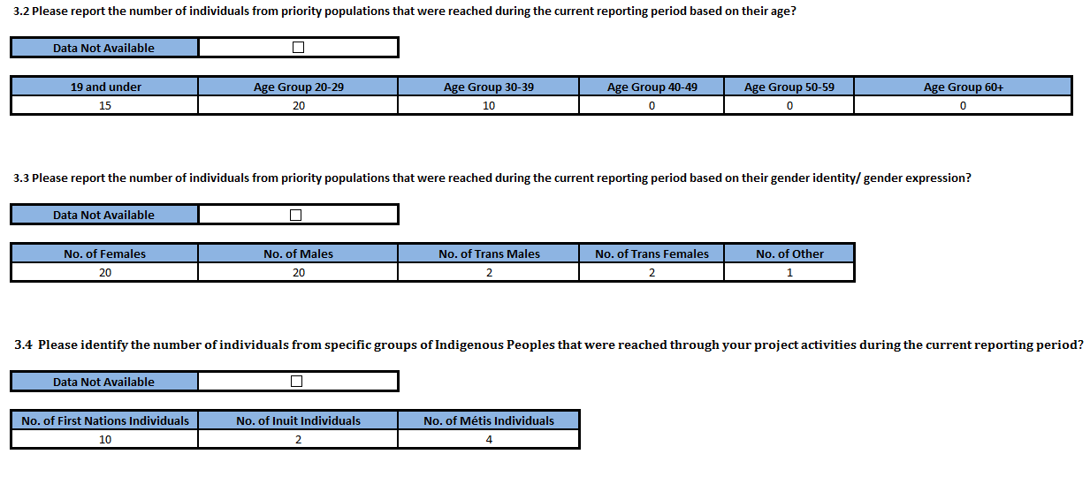
3. Reach Continued
Questions 3.2, 3.3, and 3.4
Specific demographic information about priority populations you reached
Can be estimated or obtained directly from individuals
If you don’t have the information click data not available and move on
Notes:
Questions 3.2, 3.3, and 3.4 gather specific demographic information about the priority populations you reached, specifically age, gender, and Indigenous peoples.
We understand that asking organizations to track this data could be impractical and pose serious challenges to individual privacy. You are not required to track your participants. This data can be obtained directly from your participants or estimated. If you do not track this information check the data not available box.. The question will disappear and you can move on to the next question.

Slide 32
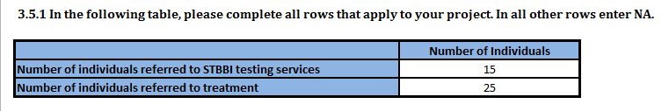
3. Reach (Continued)
Notes:
The final part of the reach section covers individuals your project connected to care and/or treatment. We are asking you to indicate by a YES, NO or a N/A if your project has referred its intended priority populations for testing and/or treatment during the current reporting period.
Specifically we’re looking for the number of individuals that you referred to STBBI testing services and the number you referred to treatment.
If either of these don’t apply to your project simple enter N/A. If your project didn’t conduct any referrals of this nature then select no or N/A in question 3.5.

Slide 33
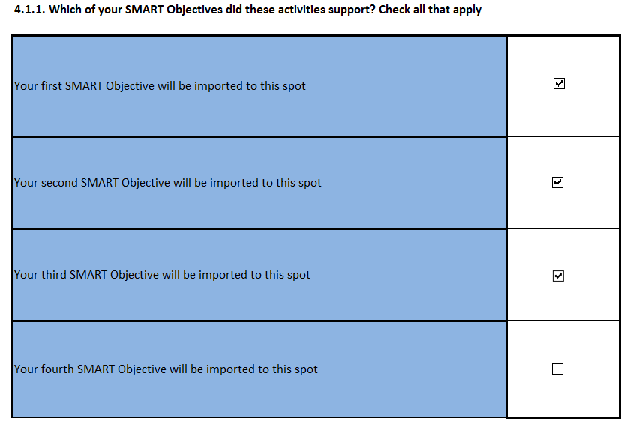
4. Social Media
Check SMART objective(s) that were supported by social media
You do not have to disaggregate your data by SMART objective
Notes:
Questions in Section 4 cover project use of social media as a means of knowledge dissemination. We’re defining social media activities as online activities that enable users to create/share information or to participate in social networking
Looking first at question 4.1.1 you’ll see a list of your SMART objectives.
We’re asking you to check off all SMART objectives that you used social media to support. Please note we’re not asking you to disaggregate your data by SMART objective. Instead you should report all your social media data together.
If you conducted social media activities in support of an objective simply put a check in the box next to it. In the example you see the first three objectives were supported by social media while the fourth was not.

Slide 34
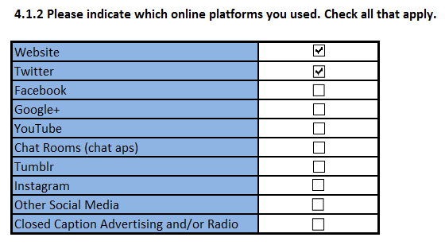
4. Social Media (Continued)
Check each platform you used
Notes:
The next step is to identify which platforms you used. Simply check the box next to each platform you used. In the example we see that Website and twitter were selected.

Slide 35
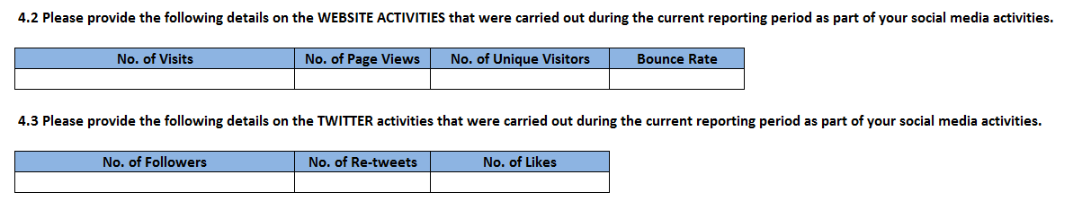
4. Social Media (Continued)
The platforms you check in question 4.1.2 will trigger further questions specific to each platform
These ask you to enter platform specific metrics
Full definitions of each metric can be found in the guide
Notes:
The platforms you check in question 4.1.2 will trigger further questions specific to each platform.
These ask you to enter platform specific metrics.
For example because we checked websites we are asked to provide the number of visits, page views, unique visitors, and the bounce rate. Similarly for twitter we are asked for the number of followers, re-tweets, and likes.

Slide 36
5. Knowledge Translation Exchange and Mobilization
Title of Product and url if available online Please describe the populations and/or audiences for which this product was designed and/or adapted | Type of Product | Please describe the populations and/or audiences for which this product was designed and/or adapted Please describe the populations and/or audiences for which this product was designed and/or adapted
Notes:
This next section covers project outputs related to the development and dissemination of knowledge and knowledge products.
We’ll go through an example on how to compete this section. We’ll start by just looking at the first half of the table in question 5.2.

Slide 37
Title of Product and url if available online Please describe the populations and/or audiences for which this product was designed and/or adapted | Type of Product | Please describe the populations and/or audiences for which this product was designed and/or adapted Please describe the populations and/or audiences for which this product was designed and/or adapted
HIV Quick Guide – www.hivquickguide.ca
HCV Quick Guide – www.hcvquickguide.ca
Notes:
To complete the table start by entering the title of the document and the url or web link if the tool is available online. We have two tools listed above. The HIV Quick Guide and the HCV Quick Guide

Slide 38
Title of Product and url if available online Please describe the populations and/or audiences for which this product was designed and/or adapted | Type of Product | Please describe the populations and/or audiences for which this product was designed and/or adapted Please describe the populations and/or audiences for which this product was designed and/or adapted
HIV Quick Guide – www.hivquickguide.ca | Pamphlets, fact sheets, booklets, posters, infographics, newsletters, periodicals
HCV Quick Guide – www.hcvquickguide.ca | Pamphlets, fact sheets, booklets, posters, infographics, newsletters, periodicals
Notes:
Once you’ve entered the title the next step is to indicate what kind of product this is by choosing from the dropdown menu. Our examples are both pamphlets.

Slide 39
Title of Product and url if available online Please describe the populations and/or audiences for which this product was designed and/or adapted | Type of Product | Please describe the populations and/or audiences for which this product was designed and/or adapted Please describe the populations and/or audiences for which this product was designed and/or adapted
HIV Quick Guide – www.hivquickguide.ca | Pamphlets, fact sheets, booklets, posters, infographics, newsletters, periodicals | People living with HIV
HCV Quick Guide – www.hcvquickguide.ca | Pamphlets, fact sheets, booklets, posters, infographics, newsletters, periodicals | People living with Hepatitis C
Notes:
Finally describe the population and/or audience for which this product is designed. It worth highlighting that this column is an open text answer, you can identify multiple populations, specific sup-populations, etc. For our examples we have People living with HIV and Hepatitis C respectively.

Slide 40
 | Did you develop this product | If yes |  | If No |  | Purpose of Product
 |  | What was the date of release | What was the date of most recent update | Who was the original source of this product | Did you adapt this product | InformationActivities | Education Activities
HIV Quick Guide | Yes | 2010 | 2014 |  |  | x
HCV Quick Guide | No |  |  | PHAC | Yes | x | x
Notes:
We’ll continue with the second half now. The first column asks Did you develop this product, in other words, is this an original product that your project created. As we see in the example the HIV guide was created by our project but the Hepatitis C guide was not.
If you did develop this product then continue to the next column and indicate when the product was first released and when it was most recently updated. As we see the HIV guide was created in 2010 and updated in 2014.
If you did not develop this product, skip to the “who was the original source” column and enter the name of the original source. For the Hepatitis C guide we see that it is a PHAC document.
Next indicate whether or not you adapted this product from its original form. A product is considered adapted if it is changed to specifically fit your project objectives. For example, changes in wording, changes to make a product appropriate for a specific population, or updates to the actual information contained in the product would be considered adaptation. Translation alone is not considered adaptation. As we see our project did adapt the Hepatitis C guide.
Finally, for all products, regardless of whether you developed them or not indicate what the purpose of the product was. If a tool was used for information activities put a check in that column, similarly if it was used for education check that column. The same tool could be used for both. In our example we see that the HIV guide was used for informational activities while the Hepatitis C guide was used for both.

Slide 41
6. Evaluation
National HIV Project
5 workshops in Ottawa
Conducted a pre post test to measure knowledge
SMART Objective | Indicator | Result of Your Data
Notes:
The final section deals with evaluation. The questions in this sections asses the progress toward achieving your project SMART objectives. This is where you will enter the data you collect regarding your evaluation activities.
We’ll go back to our 5 workshop example from section 3 to demonstrate how to fill out this table.

Slide 42
SMART Objective | Indicator | Result of Your Data
By 2022, ABC Friendship will have implemented a series of 5 workshops about effective HIV/STBBIs prevention methods in order to strengthen by 50% the capacity of 60 Indigenous people affected by or at-risk of HIV living in Gatineau; & at least 5% will report improved uptake of personal prevention methods.
Notes:
Because everything is measured against your SMART objective we’ll start by selecting the SMART objective we’re evaluating from the dropdown menu.

Slide 43
SMART Objective | Indicator | Result of Your Data
By 2022, ABC Friendship will have implemented a series of 5 workshops about effective HIV/STBBIs prevention methods in order to strengthen by 50% the capacity of 60 Indigenous people affected by or at-risk of HIV living in Gatineau; & at least 5% will report improved uptake of personal prevention methods. | Percentage increased knowledge of HIV risk factors
Notes:
Next enter the indicator that you are measuring. In this case we’re looking at how many respondents increased their knowledge of risk factors.

Slide 44
SMART Objective | Indicator | Result of Your Data
By 2022, ABC Friendship will have implemented a series of 5 workshops about effective HIV/STBBIs prevention methods in order to strengthen by 50% the capacity of 60 Indigenous people affected by or at-risk of HIV living in Gatineau; & at least 5% will report improved uptake of personal prevention methods. | Percentage increased knowledge of HIV risk factors | 45%
Notes:
Finally enter the data you’ve collected under result of your data. For our example we see that there was a 45% increase in knowledge of HIV risk factors.
This column is an open question. Because evaluations will be so varied exactly how you populate this cell will depend on the data you are collecting. If could be a percentage, a short sentence, a number etc. Our goal is to give you the most flexibility in providing your answers and then we’ll code the data on our end to roll up the results.
If you have not yet collected data for an indicator (for example, on a medium term outcome data will not likely be gathered in year 1), simply enter « data not yet available » in the appropriate column.

Slide 45
Key Dates
March 31st, 2018: You are responsible to report on project activities up to the end of this day.
April 30th 2018: Your completed CRT must be returned by this date.
Notes:
So that concludes our discussion on the CRT We’ll close with a few key dates and then open the floor up for questions.
Read slide

Slide 46
Questions

Slide 47
Thank You
For technical assistance while competing the CRT contact kevindavid.armstrong@canada.ca

